Slide 1
Lecture 4: Linear Regression B
Instructor: Yang Xu
Slides adopted from Xiaobai Liu

Slide 2
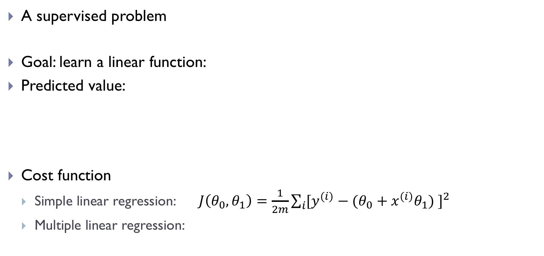
Recap: linear regression
A supervised problem
Goal: learn a linear function:
Predicted value:
Cost function
Simple linear regression: $J\left(θ_{0},θ_{1}\right)=\frac{1}{2m}\sum_{i}{{[y^{(i)}−(θ_{0}+x^{(i)}θ_{1}) ]}^{2}}$
Multiple linear regression:

Slide 3
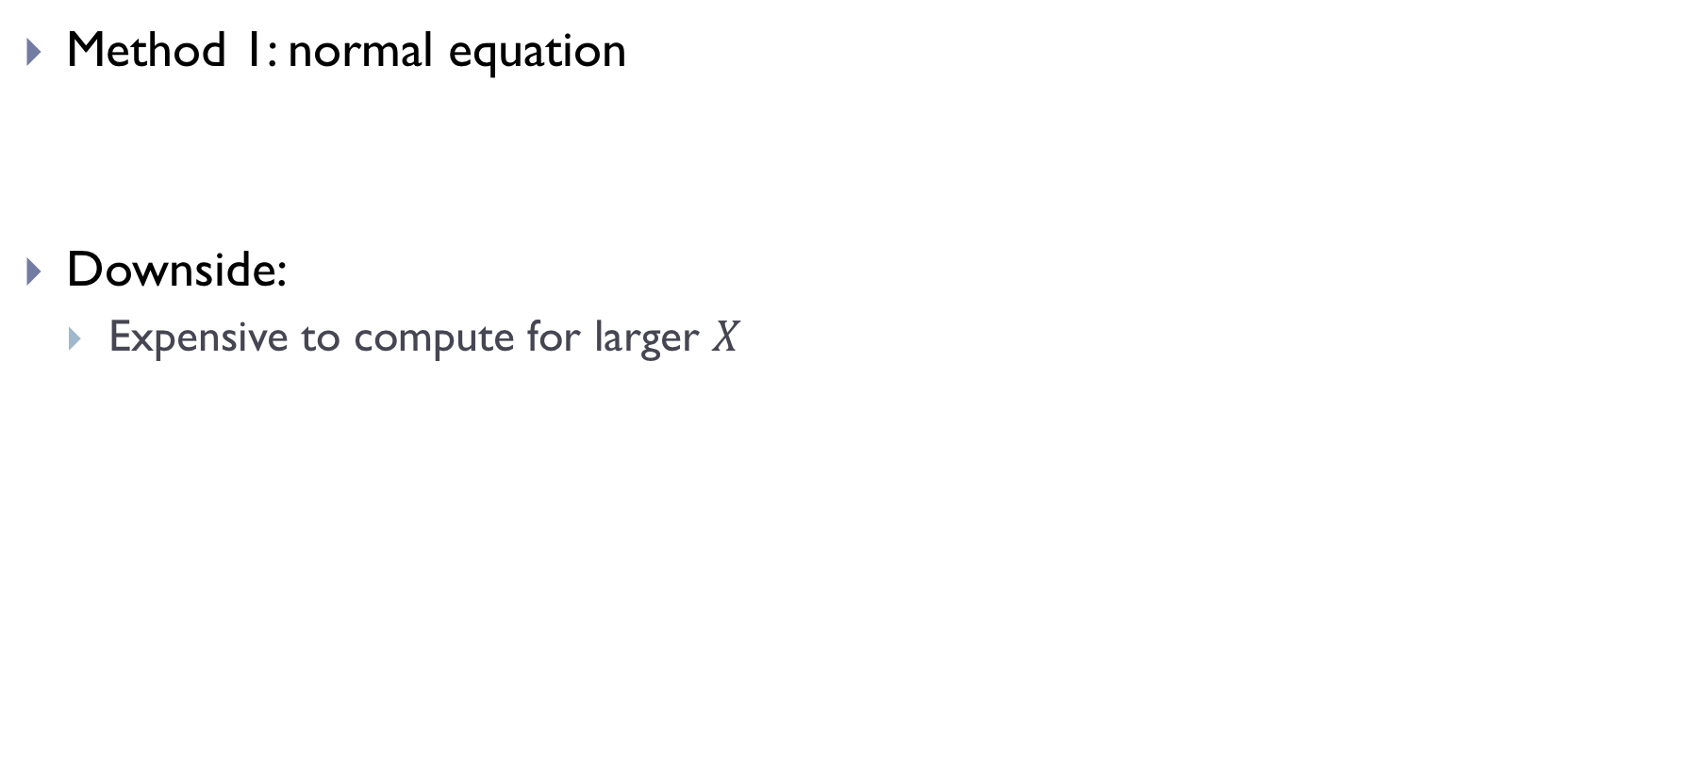
Review
Method 1: normal equation
Downside:
Expensive to compute for larger $X$

Slide 4
Outline
Task Formulation
Cost Function
Method 1: Normal Equation
Method 2: Gradient Descent

Slide 5
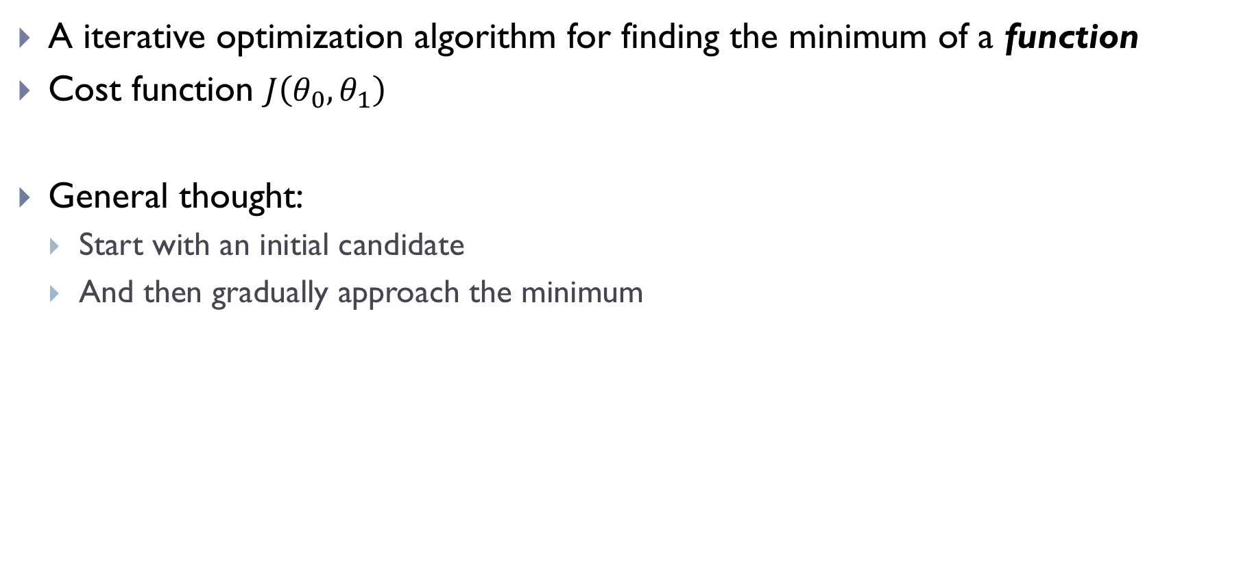
Term: Gradient Descent
A iterative optimization algorithm for finding the minimum of a function
Cost function $J\left(θ_{0},θ_{1}\right)$
General thought:
Start with an initial candidate
And then gradually approach the minimum

Slide 6
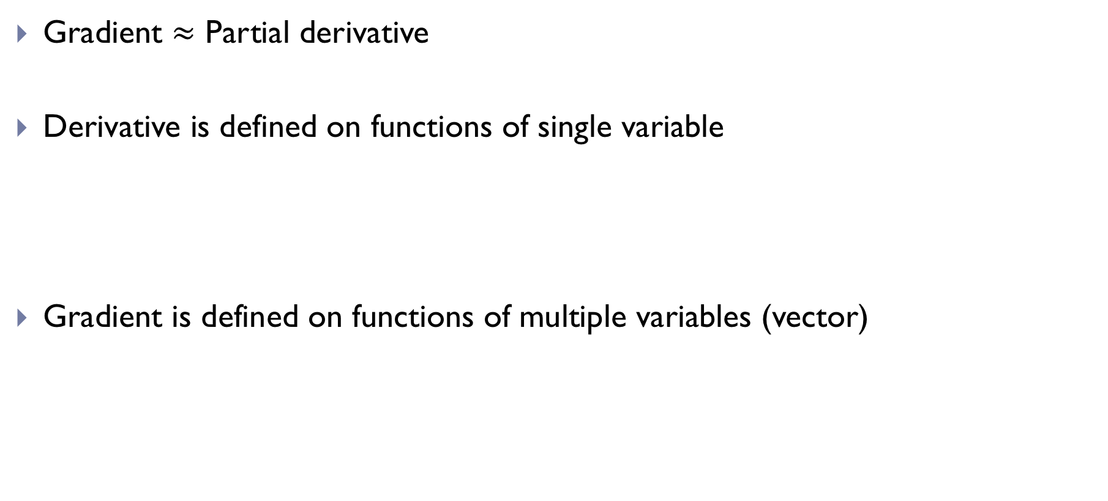
What is gradient?
Gradient $≈$ Partial derivative
Derivative is defined on functions of single variable
Gradient is defined on functions of multiple variables (vector)

Slide 7
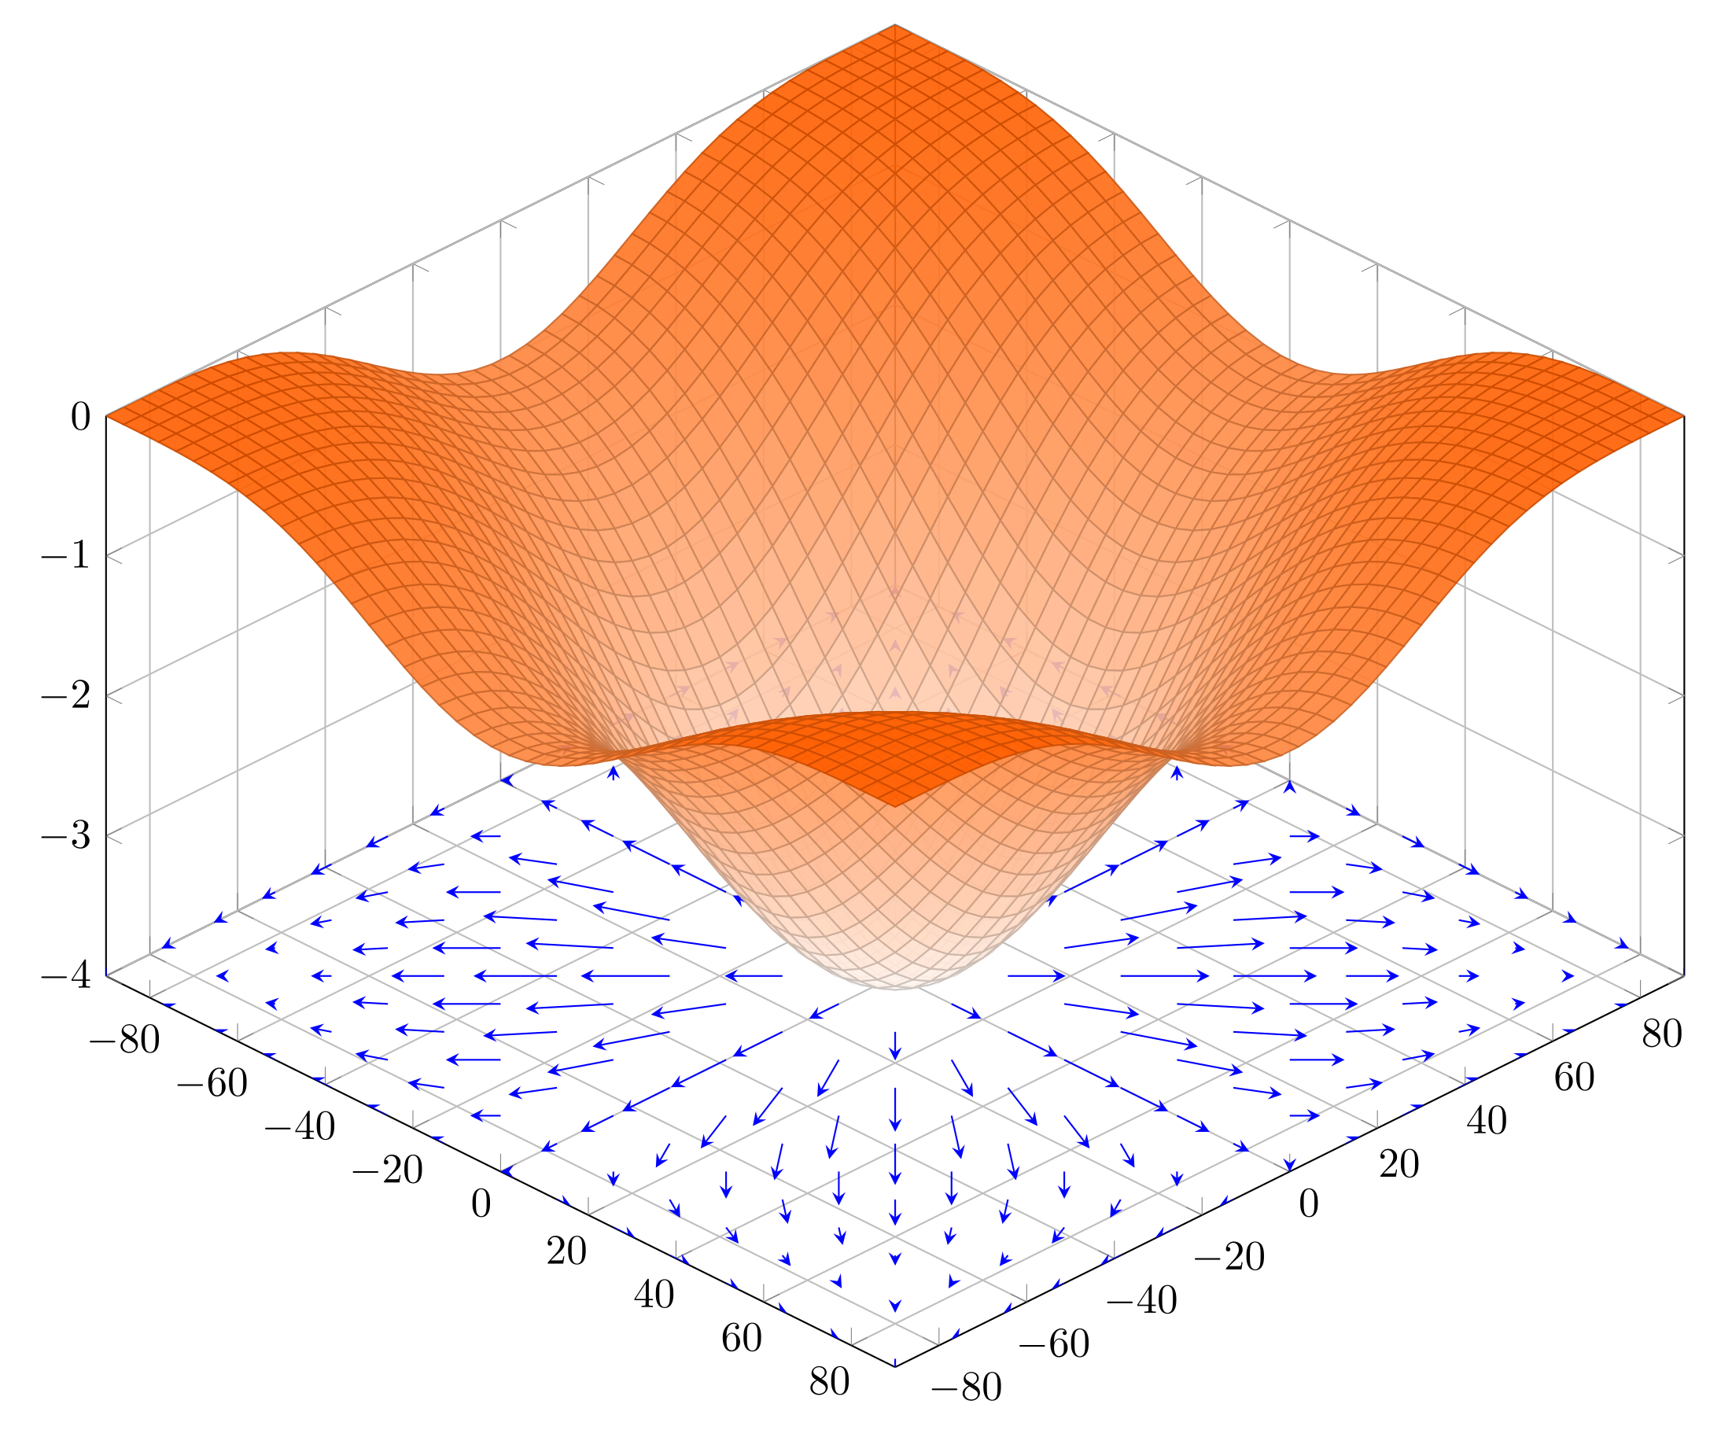
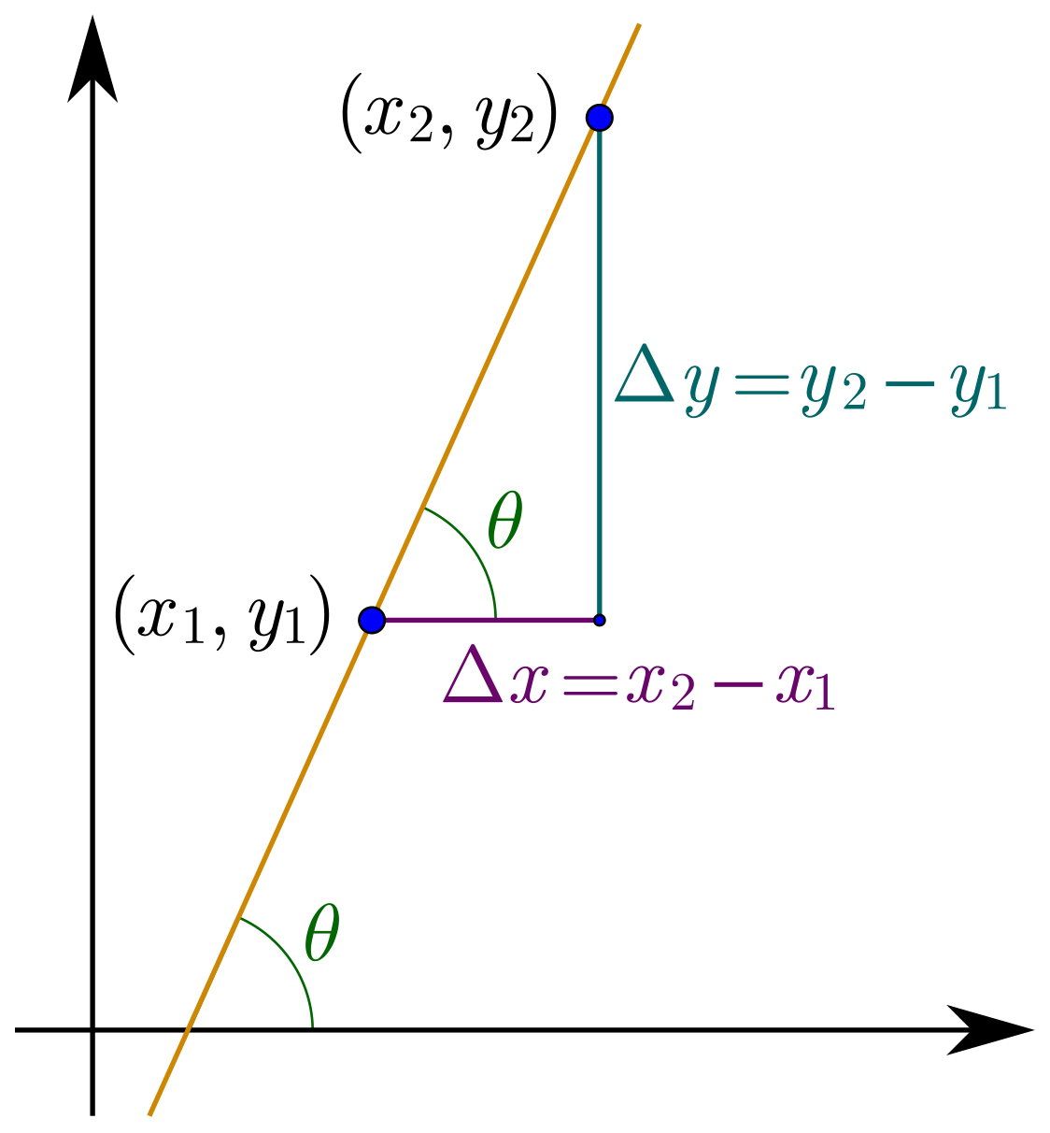

Gradient $≈$ derivative
Measures the sensitivity: how much the output changes if the input changes a little bit
See grey lines

Slide 8
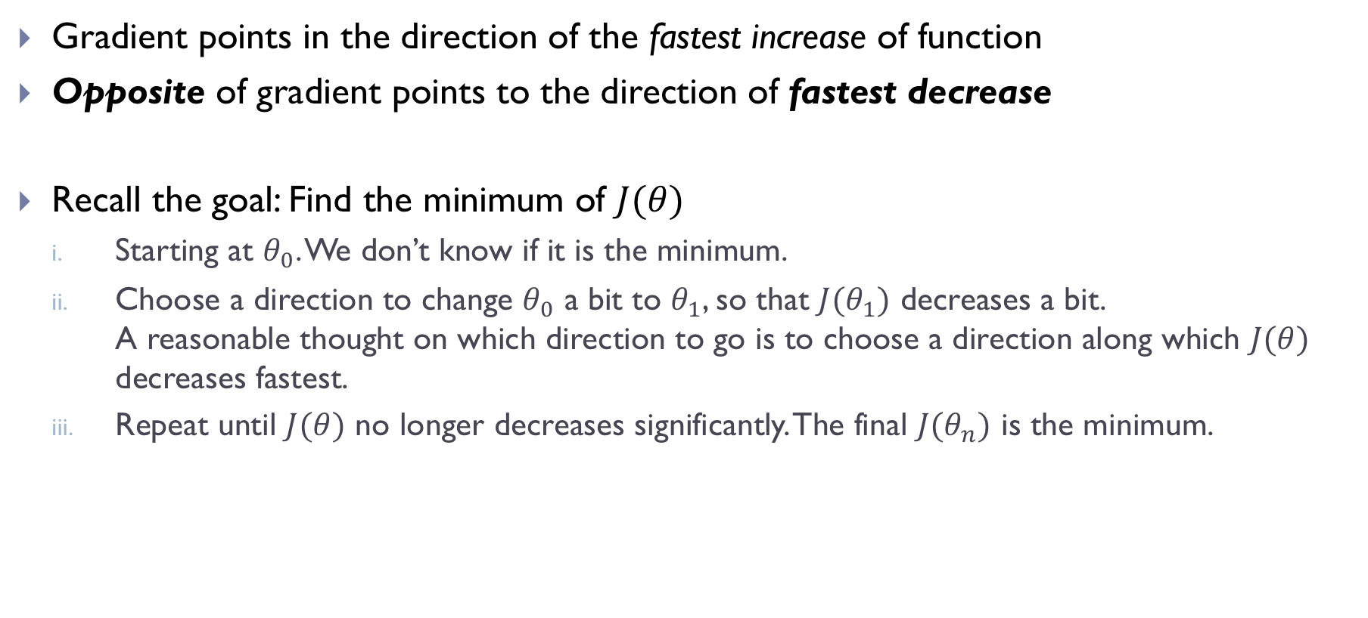
How does gradient help to find the minimum?
Gradient points in the direction of the fastest increase of function
Opposite of gradient points to the direction of fastest decrease
Recall the goal: Find the minimum of $J(θ)$
Starting at $θ_{0}$. We don’t know if it is the minimum.
Choose a direction to change $θ_{0}$ a bit to $θ_{1}$, so that $J(θ_{1})$ decreases a bit. A reasonable thought on which direction to go is to choose a direction along which $J(θ)$ decreases fastest.
Repeat until $J(θ)$ no longer decreases significantly. The final ${J(θ}_{n})$ is the minimum.

Slide 9

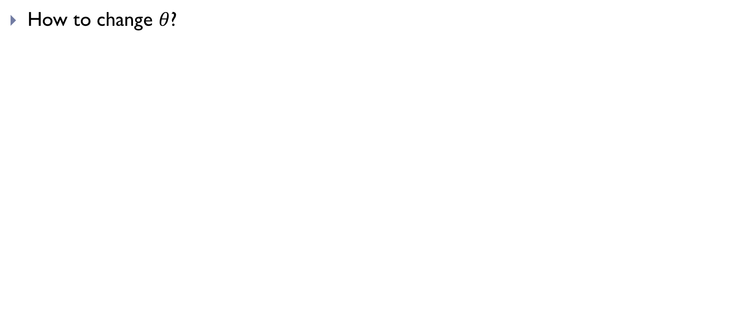
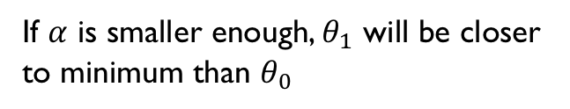

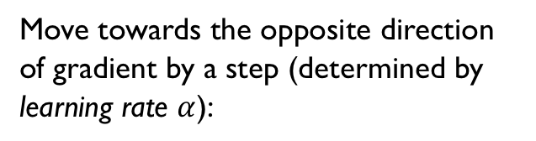
1-D demo of GD
How to change $θ$?
Move towards the opposite direction of gradient by a step (determined by learning rate $α$):
Therefore, $θ_{1}>θ_{0}$
If $α$ is smaller enough, $θ_{1}$ will be closer to minimum than $θ_{0}$
One iteration
Repeat until a satisfactory $θ_{n}$ is reached

Slide 10
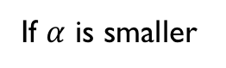
1-D demo of GD (cont.)
Different initial position
Move towards the opposite direction of gradient:
As a result
If $α$ is smaller
One iteration done. Repeat until satisfied.
No matter where the initial point is, the principle holds: move to the opposite direction of gradient

Slide 11
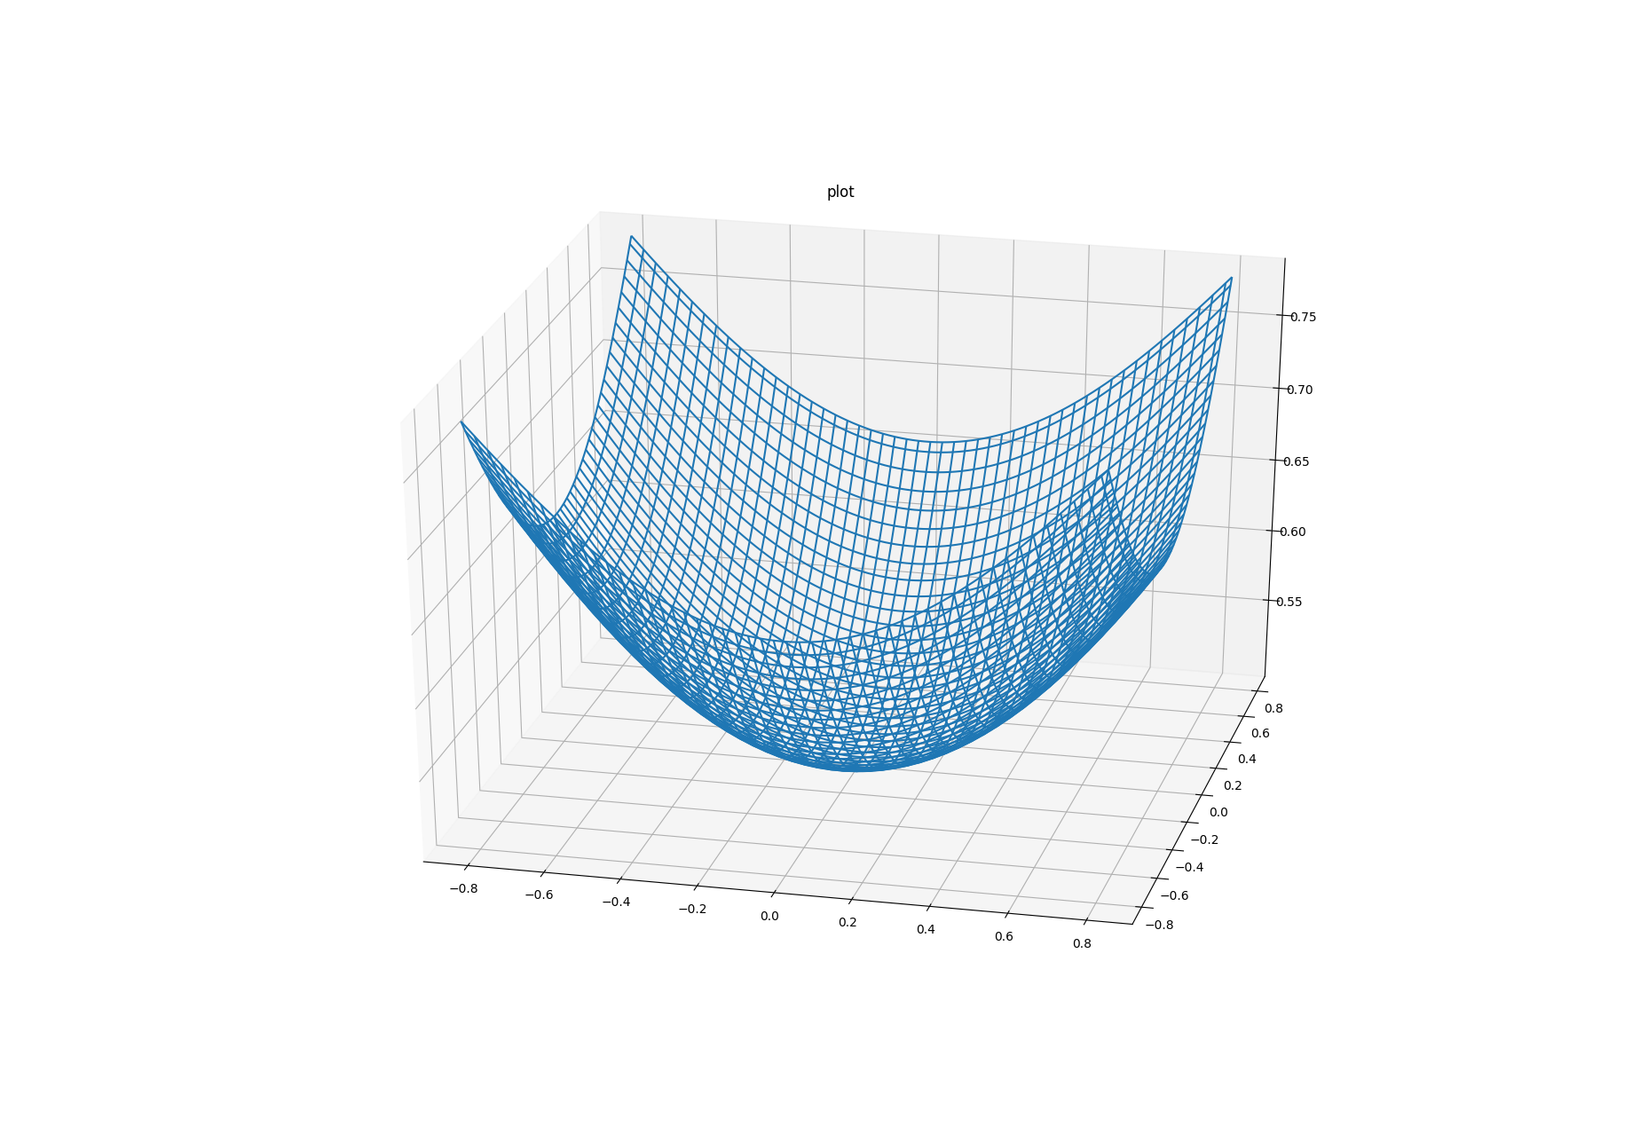
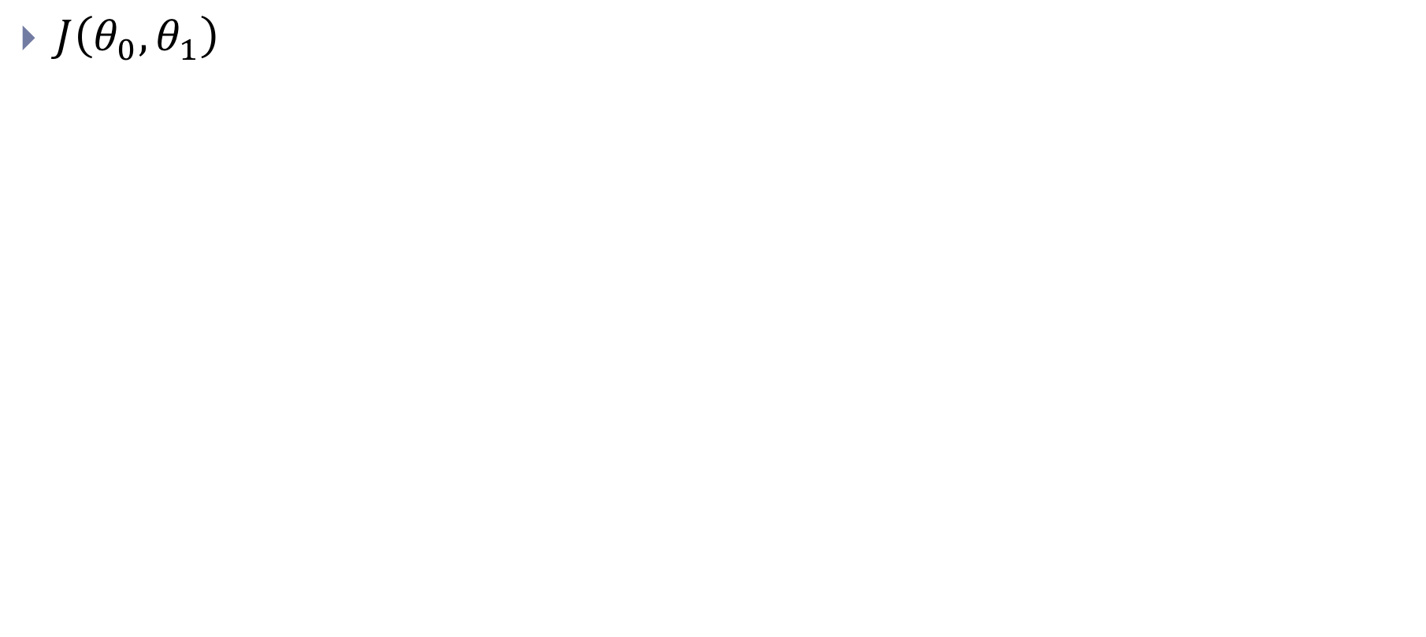
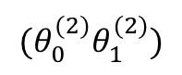
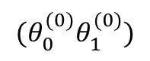
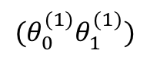
2-D demo of GD
$J\left(θ_{0},θ_{1}\right)$
Iteration 1
Move towards the opposite of gradient
$${(θ}_{0}^{(0)}θ_{1}^{(0)})$$
$${(θ}_{0}^{(1)}θ_{1}^{(1)})$$
$${(θ}_{0}^{(2)}θ_{1}^{(2)})$$
Iteration 2
Repeat until satisfied

Slide 12
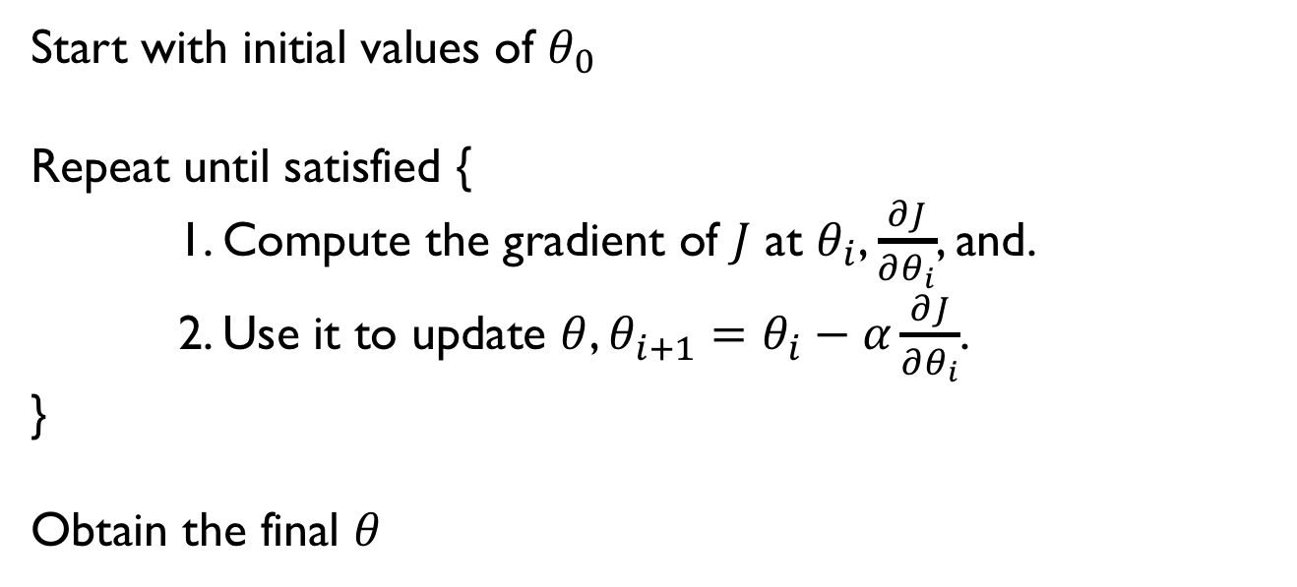
GD algorithm summary
Start with initial values of $θ_{0}$
Repeat until satisfied {
1. Compute the gradient of $J$ at $θ_{i}$, $\frac{∂J}{∂θ_{i}}$, and.
2. Use it to update $θ$, $θ_{i+1}=θ_{i}−α\frac{∂J}{∂θ_{i}}$.
}
Obtain the final $θ$

Slide 13
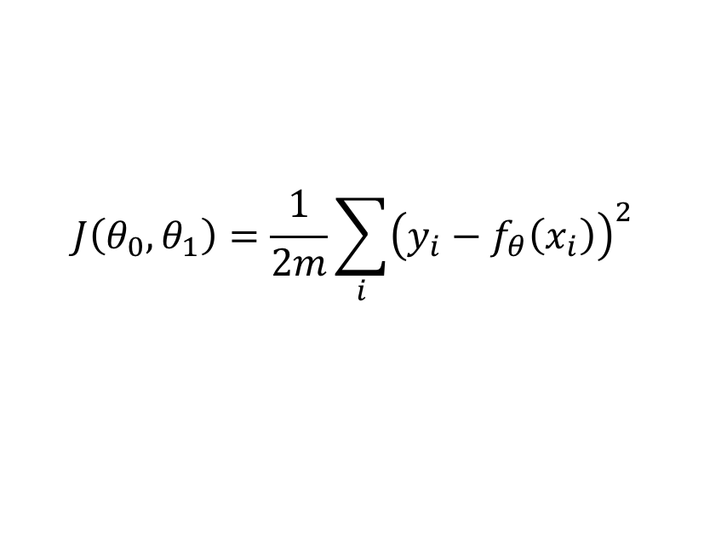
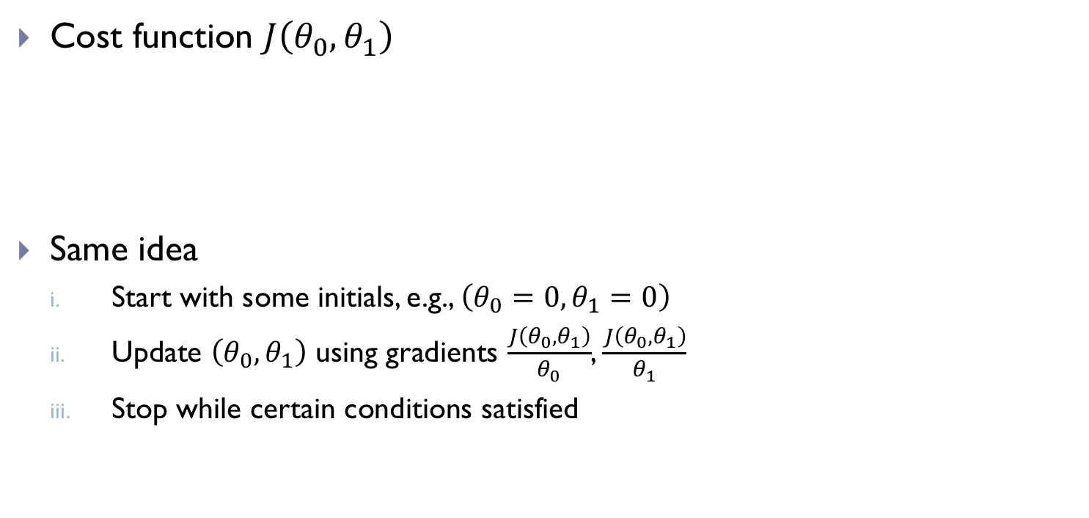
GD for linear regression
Cost function $J\left(θ_{0},θ_{1}\right)$
Same idea
Start with some initials, e.g., $\left(θ_{0}=0,θ_{1}=0\right)$
Update $\left(θ_{0},θ_{1}\right)$ using gradients $\frac{J\left(θ_{0},θ_{1}\right)}{θ_{0}}$, $\frac{J\left(θ_{0},θ_{1}\right)}{θ_{1}}$
Stop while certain conditions satisfied
$$J\left(θ_{0},θ_{1}\right)=\frac{1}{2m}\sum_{i}{{\left(y_{i}−f_{θ}\left(x_{i}\right)\right)}^{2}}$$

Slide 14
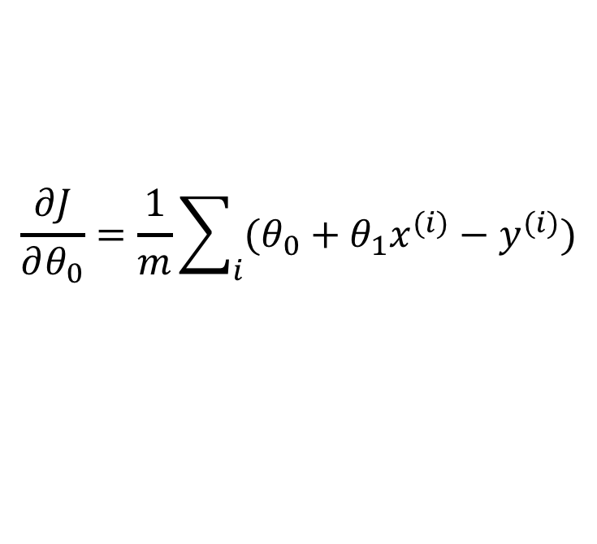
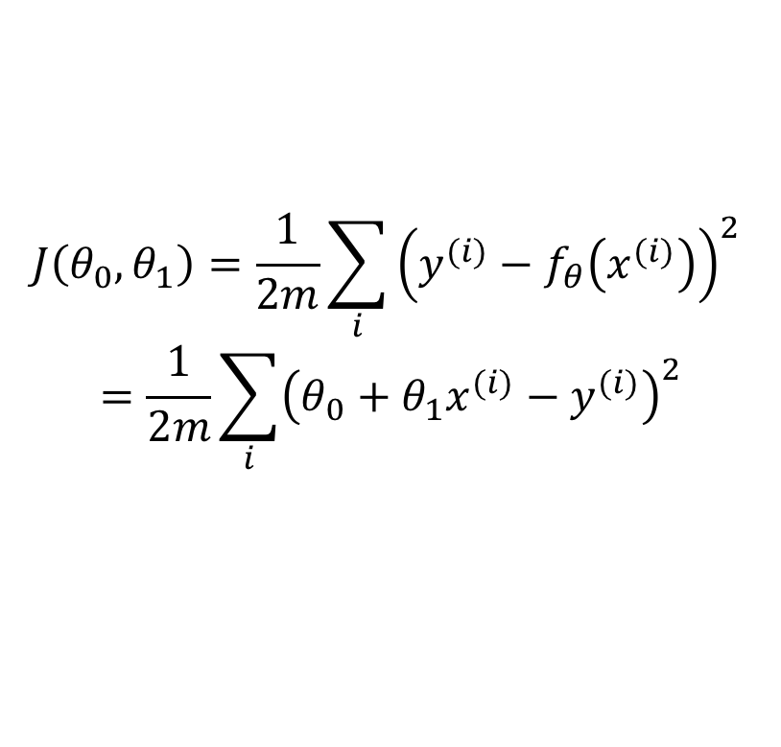
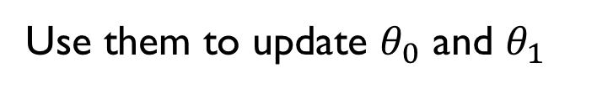
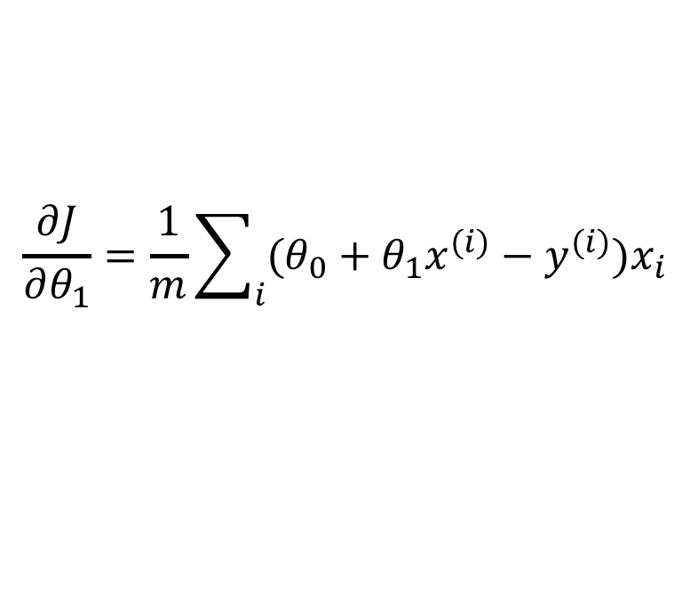
GD for simple linear regression
Cost Function
$$J\left(θ_{0},θ_{1}\right)=\frac{1}{2m}\sum_{i}{{\left(y^{(i)}−f_{θ}\left(x^{(i)}\right)\right)}^{2} }$$
$$=\frac{1}{2m}\sum_{i}{{\left(θ_{0}+θ_{1}x^{(i)}−y^{(i)}\right)}^{2}}$$
Gradient
$$\frac{∂J}{∂θ_{0}}=\frac{1}{m}\sum_{i}{(θ_{0}+θ_{1}x^{(i)}−y^{(i)})}$$
Use them to update $θ_{0}$ and $θ_{1}$
$$\frac{∂J}{∂θ_{1}}=\frac{1}{m}\sum_{i}{(θ_{0}+θ_{1}x^{(i)}−y^{(i)})x_{i}}$$

Slide 15
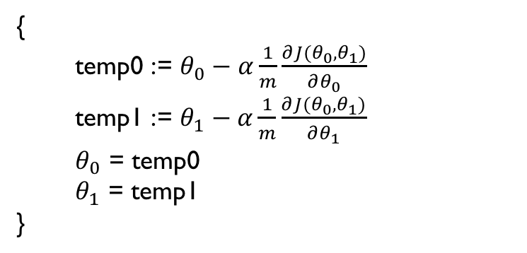
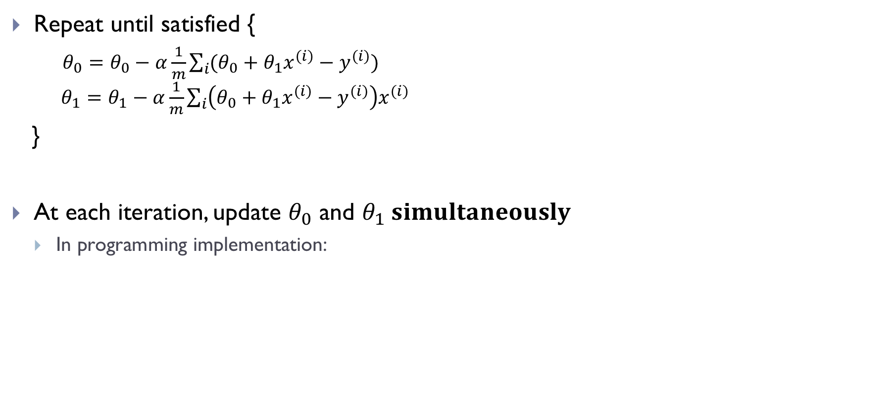
GD for simple linear regression
Repeat until satisfied {
$θ_{0}=θ_{0}−α\frac{1}{m}\sum_{i}{(θ_{0}+θ_{1}x^{(i)}−y^{(i)})}$ $θ_{1}=θ_{1}−α\frac{1}{m}\sum_{i}{\left(θ_{0}+θ_{1}x^{(i)}−y^{(i)}\right)x^{(i)}}$
}
At each iteration, update $θ_{0}$ and $θ_{1} simultaneously$
In programming implementation:
{
temp0 := $θ_{0}−α\frac{1}{m}\frac{∂J(θ_{0},θ_{1})}{∂θ_{0}}$
temp1 := $θ_{1}−α\frac{1}{m}\frac{∂J(θ_{0},θ_{1})}{∂θ_{1}}$
$θ_{0}$ = temp0
$θ_{1}$ = temp1
}

Slide 16
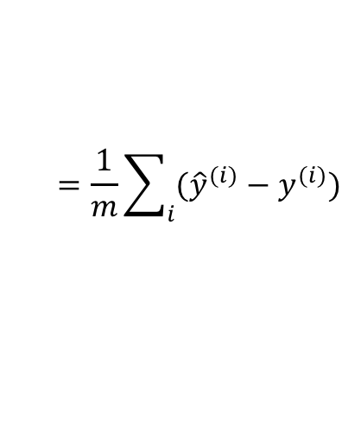
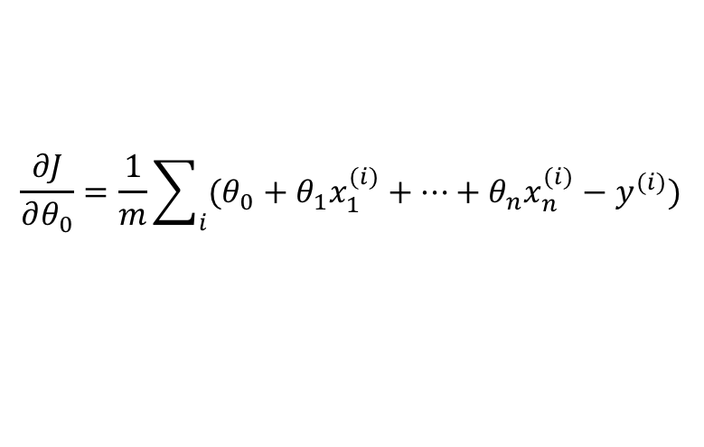
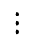
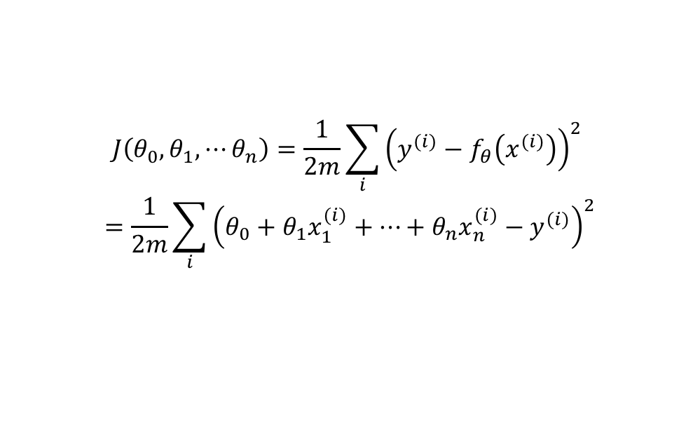
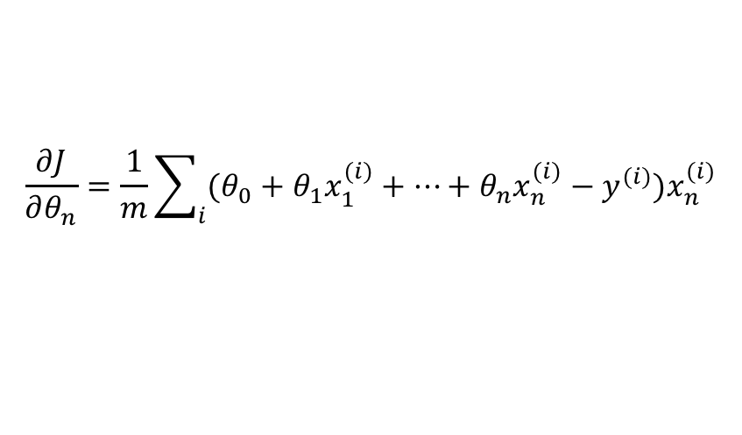
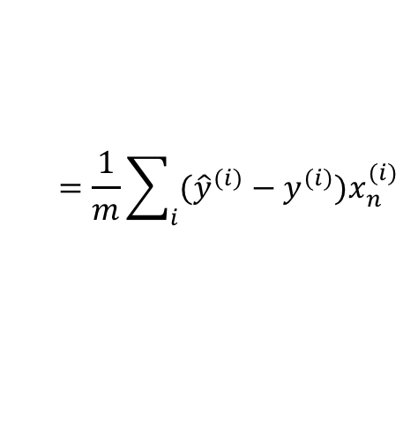
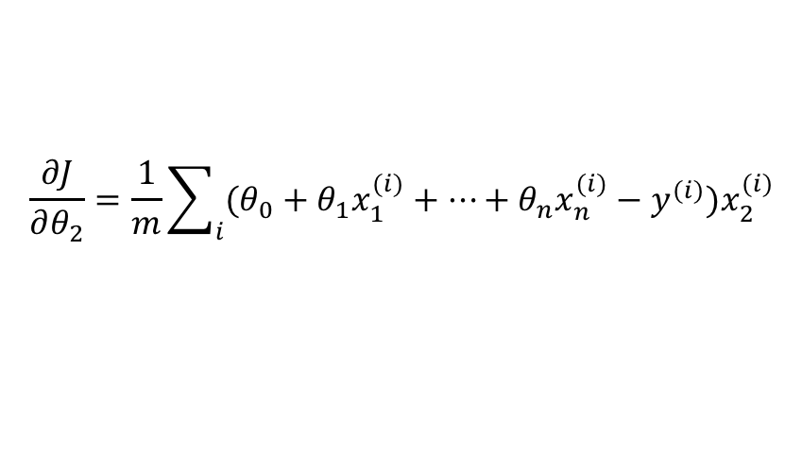
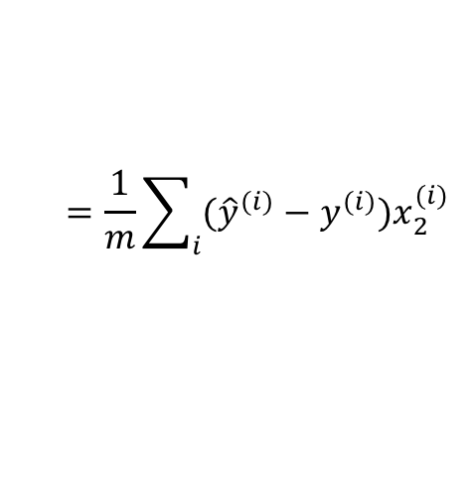
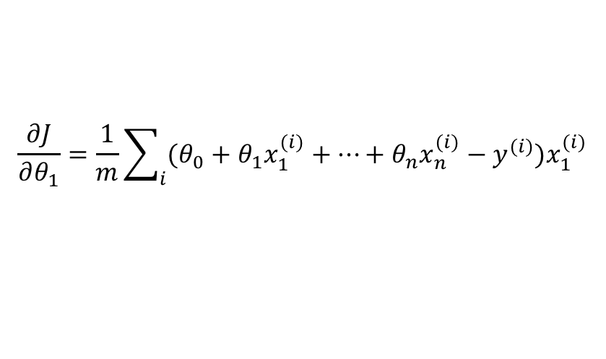
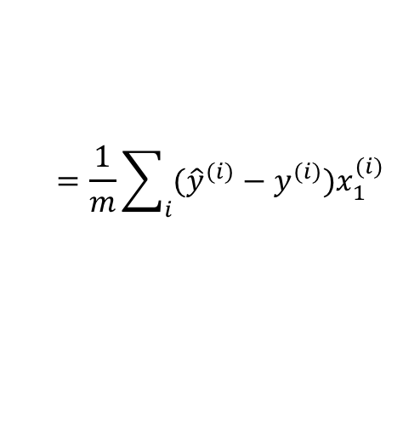
GD for multiple linear regression
Cost function
Gradient
$$J\left(θ_{0},θ_{1},⋯θ_{n}\right)=\frac{1}{2m}\sum_{i}{{\left(y^{(i)}−f_{θ}\left(x^{(i)}\right)\right)}^{2} }$$
$$=\frac{1}{2m}\sum_{i}{{\left(θ_{0}+θ_{1}x_{1}^{(i)}+⋯+θ_{n}x_{n}^{(i)}−y^{(i)}\right)}^{2}}$$
$$\frac{∂J}{∂θ_{0}}=\frac{1}{m}\sum_{i}{(θ_{0}+θ_{1}x_{1}^{(i)}+⋯+θ_{n}x_{n}^{(i)}−y^{(i)})}$$
$$=\frac{1}{m}\sum_{i}{({\hat{y}}^{(i)}−y^{(i)})}$$
$$\frac{∂J}{∂θ_{1}}=\frac{1}{m}\sum_{i}{(θ_{0}+θ_{1}x_{1}^{(i)}+⋯+θ_{n}x_{n}^{(i)}−y^{(i)})x_{1}^{(i)}}$$
$$=\frac{1}{m}\sum_{i}{({\hat{y}}^{(i)}−y^{(i)})x_{1}^{(i)}}$$
$$\frac{∂J}{∂θ_{2}}=\frac{1}{m}\sum_{i}{(θ_{0}+θ_{1}x_{1}^{(i)}+⋯+θ_{n}x_{n}^{(i)}−y^{(i)})x_{2}^{(i)}}$$
$$=\frac{1}{m}\sum_{i}{({\hat{y}}^{(i)}−y^{(i)})x_{2}^{(i)}}$$
$$⋮$$
$$\frac{∂J}{∂θ_{n}}=\frac{1}{m}\sum_{i}{(θ_{0}+θ_{1}x_{1}^{(i)}+⋯+θ_{n}x_{n}^{(i)}−y^{(i)})x_{n}^{(i)}}$$
$$=\frac{1}{m}\sum_{i}{({\hat{y}}^{(i)}−y^{(i)})x_{n}^{(i)}}$$

Slide 17
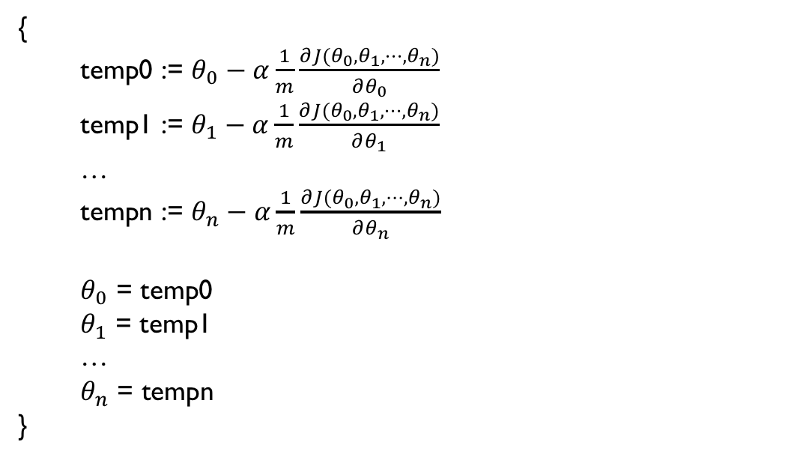
GD for multiple linear regression (cont.)
Update parameters simultaneously
{
temp0 := $θ_{0}−α\frac{1}{m}\frac{∂J(θ_{0},θ_{1},⋯,θ_{n})}{∂θ_{0}}$
temp1 := $θ_{1}−α\frac{1}{m}\frac{∂J(θ_{0},θ_{1},⋯,θ_{n})}{∂θ_{1}}$
…
tempn := $θ_{n}−α\frac{1}{m}\frac{∂J(θ_{0},θ_{1},⋯,θ_{n})}{∂θ_{n}}$
$θ_{0}$ = temp0
$θ_{1}$ = temp1
…
$θ_{n}$ = tempn
}

Slide 18
Case Study: predicting unit prices
Scenario: you go to the café everyday for lunch.
Your lunch is a fixed combo of salad, fries, and drink (sold by weight)
The proportion of each varies.
Day1: 2 oz of salad, 2 oz of fries, and 3 oz of drink
Day 2: 3 oz of salad, 1 oz of fries, and 2 oz of drink
The cashier only tells you the total price
After several days, can you figure out the unit price (i.e., $/oz) of them?
Gradient Descent solution?

Slide 19
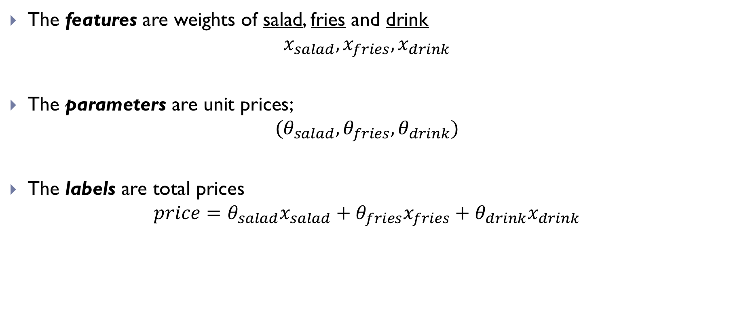
A multiple linear regression problem
The features are weights of salad, fries and drink
$$x_{salad}, x_{fries},x_{drink}$$
The parameters are unit prices;
$$(θ_{salad},θ_{fries}, θ_{drink})$$
The labels are total prices
$$price={θ_{salad}x}_{salad}+θ_{fries}x_{fries}+θ_{drink}x_{drink}$$

Slide 20
GD Game
Cashier (Xu)
Set up the unit prices for (salad, fries, drink), respectively, e.g., ($5,$5,$5)
For each food, its unit price is between $1 and $10
Students (each participant)
Randomly guess the unit prices, e.g., ($2,$3,$4)
Round-1with unit prices ($2,$3,$4) :
Order a meal, e.g., (1, 3, 1) for (salad, fries, drink)
Estimate the order price,: i.e. (1,3,1).*($2,$3,$4)=$15(on your own)
Query the true order price,: (1,3,1).*($5,$5,$5)=$25 (provided by Xu)
Adjust your estimation of the unit prices: increase or decrease; e.g., from ($2,$3,$4) to ($9,$8,$8)
Round-2 with unit prices ($9,$8,$8):
Order a meal, e.g., (2,1,1) for (salad, fries, drink)
Estimate the order price: (2,1,1)* ($9,$8,$8)=$34
Query the true order price: (2,1,1)* ($5,$5,$5)=$20
Adjust your estimation: decrease; from ($9,$8,$8) to ($5,$8,$7)
Round -3 with ($5,$8,$7)
Same.
Winner
being closest to the true unit prices

Slide 21
Team 1
Team 2
Team 3
Guess Unit Price: $(?,?,?)
Guess Unit Price: $(?,?,?)
Round 1
Round 1
Order: [?,?,?]
Est Price: $?
True Price: $?
Decision: increase
Order: [?,?,?]
Est Price: $?
True Price: ?
Decision: increase
Guess Unit Price:$ (?,?,?)
Guess Unit Price: $(?,?,?)
Round 2
Round 2
Order: [?,?,?]
Est Price: $?
True Price: $?
Decision: increase
Order: [?,?,?]
Est Price: $?
True Price: $?
Decision: increase
Guess Unit Price: $(?,?,?)
Guess Unit Price: $(?,?,?)
Round 3
Round 3
…
…

Slide 22

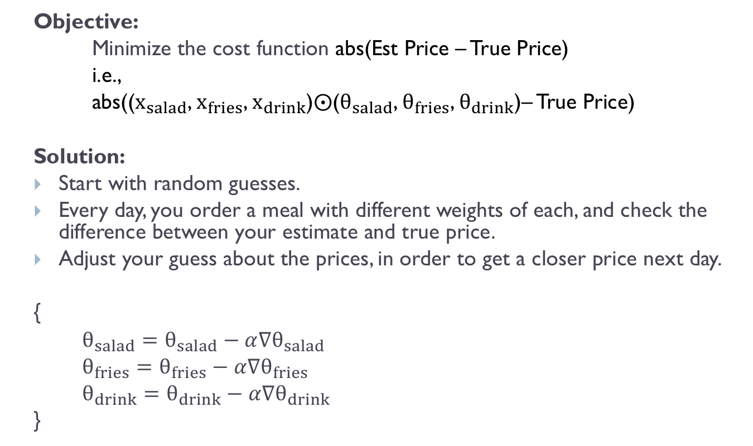
Summarize the strategy
Objective:
Minimize the cost function abs(Est Price – True Price)
i.e.,
abs(($x_{salad}$, $x_{fries}$, $x_{drink}$)$⨀$($θ_{salad}$, $θ_{fries}$, $θ_{drink}$)– True Price)
Solution:
Start with random guesses.
Every day, you order a meal with different weights of each, and check the difference between your estimate and true price.
Adjust your guess about the prices, in order to get a closer price next day.
{
$θ_{salad}=θ_{salad}−$ $α∇θ_{salad}$
$θ_{fries}=θ_{fries}−α∇θ_{fries}$
$θ_{drink}=θ_{drink}−α∇θ_{drink}$
}
What are $∇θ_{salad}$, $∇θ_{fries}$, and $∇θ_{drink}$?
The gradients!

Slide 23
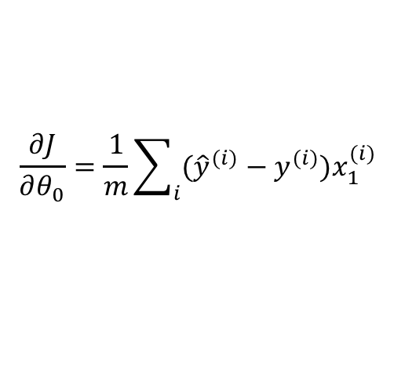
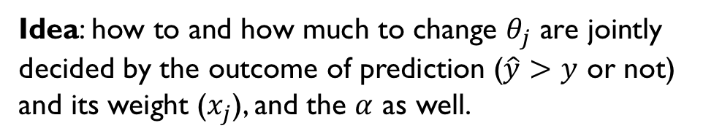
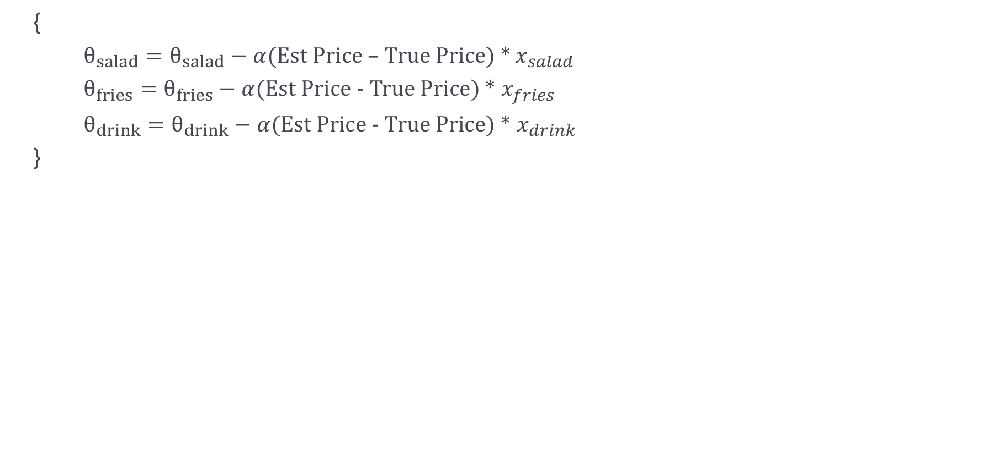
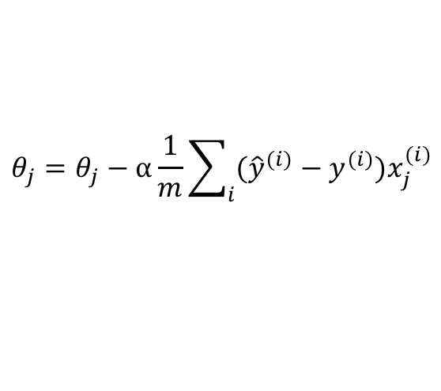
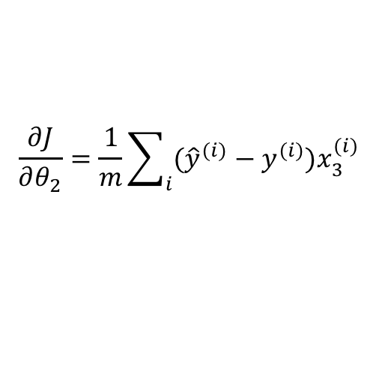
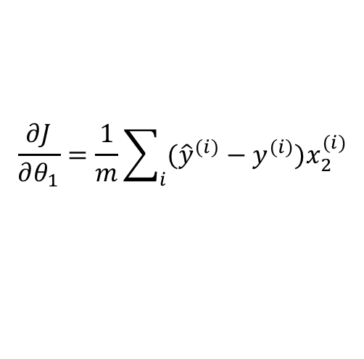
Back to the formula of GD
{
$θ_{salad}=θ_{salad}−$ $α$(Est Price – True Price) * $x_{salad}$
$θ_{fries}=θ_{fries}−α$(Est Price - True Price) * $x_{fries}$
$θ_{drink}=θ_{drink}−α$(Est Price - True Price) * $x_{drink}$
}
$$\frac{∂J}{∂θ_{0}}=\frac{1}{m}\sum_{i}{({\hat{y}}^{(i)}−y^{(i)})x_{1}^{(i)}}$$
$$θ_{j}=θ_{j}−α\frac{1}{m}\sum_{i}{({\hat{y}}^{(i)}−y^{(i)})x_{j}^{(i)}}$$
j th parameter
j th component in feature
$$\frac{∂J}{∂θ_{1}}=\frac{1}{m}\sum_{i}{({\hat{y}}^{(i)}−y^{(i)})x_{2}^{(i)}}$$
Difference between prediction and truth
$$\frac{∂J}{∂θ_{2}}=\frac{1}{m}\sum_{i}{({\hat{y}}^{(i)}−y^{(i)})x_{3}^{(i)}}$$
Idea: how to and how much to change $θ_{j}$ are jointly decided by the outcome of prediction ($\hat{y}>y$ or not) and its weight ($x_{j}$), and the $α$ as well.

Slide 24
Analogy of parameter updating
Equalizer

Slide 25
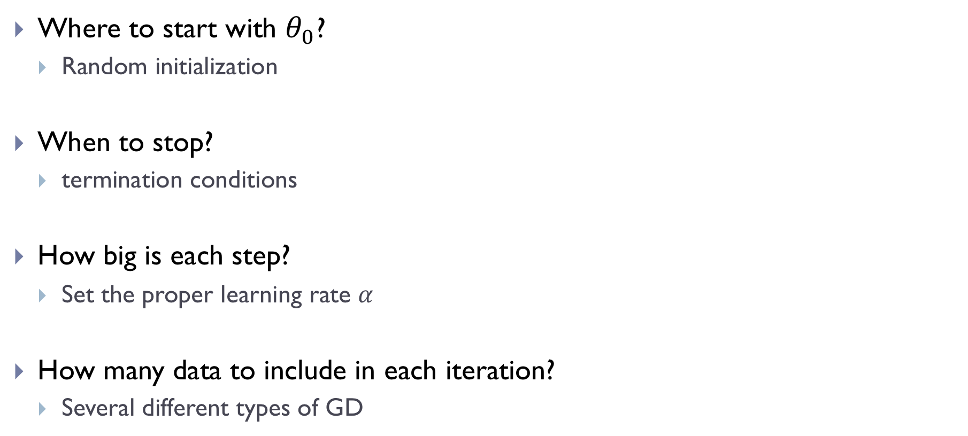
Some common practices
Where to start with $θ_{0}$?
Random initialization
When to stop?
termination conditions
How big is each step?
Set the proper learning rate $α$
How many data to include in each iteration?
Several different types of GD

Slide 26
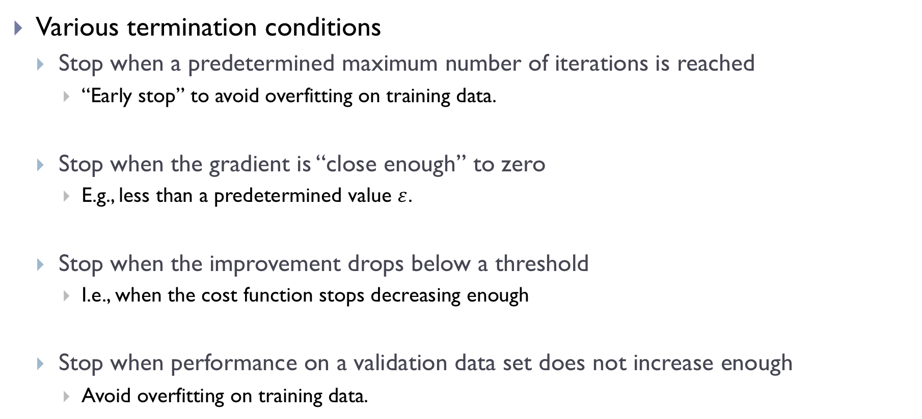
When to stop
Various termination conditions
Stop when a predetermined maximum number of iterations is reached
“Early stop” to avoid overfitting on training data.
Stop when the gradient is “close enough” to zero
E.g., less than a predetermined value $ε$.
Stop when the improvement drops below a threshold
I.e., when the cost function stops decreasing enough
Stop when performance on a validation data set does not increase enough
Avoid overfitting on training data.

Slide 27
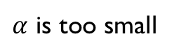

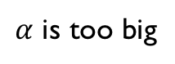
How to set learning rate $α$
$α$ is too big
$α$ is too small
Never converge to the minimum
Training is too slow

Slide 28
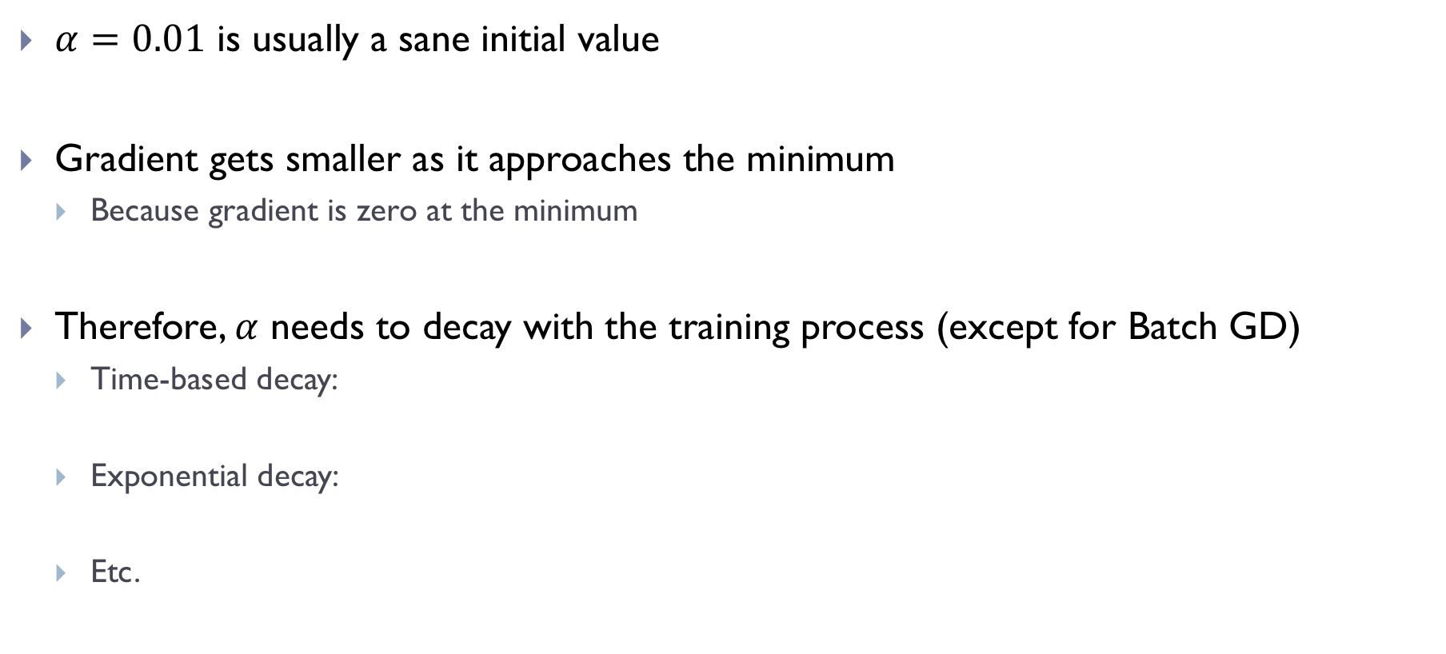

Selection and adaptation of learning rate
$α=0.01$ is usually a sane initial value
Gradient gets smaller as it approaches the minimum
Because gradient is zero at the minimum
Therefore, $α$ needs to decay with the training process (except for Batch GD)
Time-based decay:
Exponential decay:
Etc.
What if $α$ does not decay?

Slide 29
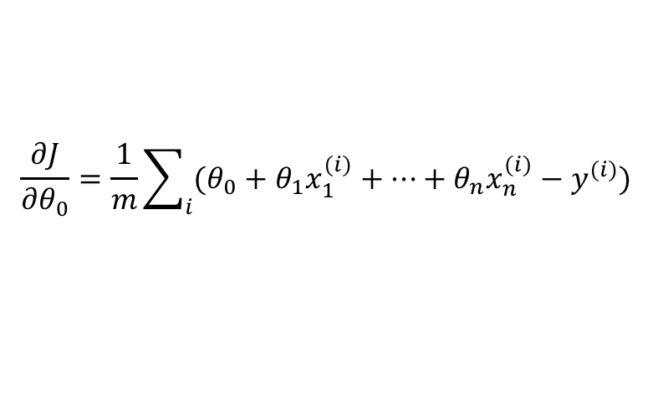

Types of GD
Batch Gradient Descent
Compute gradient using all data on each iteration, and perform parameters update
Advantages
Guaranteed to converge (constant $α$ may work)
The gradient estimated is unbiased, because all data are used
Give straight trajectory towards the minimum
In theory, it is guaranteed to converge to a minimum
Disadvantage
Slow to compute each iteration when we have large data
$$\frac{∂J}{∂θ_{0}}=\frac{1}{m}\sum_{i}{(θ_{0}+θ_{1}x_{1}^{(i)}+⋯+θ_{n}x_{n}^{(i)}−y^{(i)})}$$

Slide 30

Types of GD (cont.)
Minibatch Gradient Descent
In each iteration, compute gradient using a subset of data with fixed size (batch size)
Advantages
Faster to compute one iteration
Randomly shuffling data avoids redundant examples in each iteration
Disadvantages
Will not converge: the cost function wanders around the minimum
Learning rate decay required
$$\frac{∂J}{∂θ_{0}}=\frac{1}{batch size}\sum_{i}{(θ_{0}+θ_{1}x_{1}^{(i)}+⋯+θ_{n}x_{n}^{(i)}−y^{(i)})}$$

Slide 31

Types of GD (cont.)
Stochastic Gradient Descent (SGD)
In each iteration, use one example from data to compute gradient and perform update
Advantages and disadvantages
Similar to Minibatch Gradient Descent
Adds even more noise in learning process than Minibatch GD, which may help model generalize better
$$\frac{∂J}{∂θ_{0}}=θ_{0}+θ_{1}x_{1}^{(i)}+⋯+θ_{n}x_{n}^{(i)}−y^{(i)}$$

Slide 32
Comparison of three GDs

Slide 33
Other tricks
Normalize the data so that all features are in similar scale
Takes longer to converge

Slide 34



Tensorflow example of linear regression
https://github.com/aymericdamien/TensorFlow-Examples/
One feature to predict one output

Slide 35


Tensorflow example of linear regression (cont.)
tf.Placehoder is the entry point of a computation graph
Graph contains parameters to be trained, and describes how they are connected
A tf.Variable represent a parameter that can be updated by training algorithm
Build the model by defining how variables are connected by operations
Define how cost is computed

Slide 36

Tensorflow example of linear regression (cont.)
Choose an optimizer (here, using GD), and specify which variable to minimize, and learning rate.
The optimizer will update all parameters automatically when it is evaluated.

Slide 37

Tensorflow example of linear regression (cont.)
Start a session
Epoch: a pass of the entire data
To evaluate optimizer, needs to feed real data (x, y) to the placeholders (X, Y)
To compute cost, needs to feed the whole data (train_X, train_Y)

Slide 38


Tensorflow example of linear regression (cont.)

Slide 39

Recap
Gradient Descent algorithm
A iterative way to find the minimum of cost function
Start with initial values of $θ_{0}$
Repeat until satisfied {
1. Compute the gradient of $J$ at $θ_{i}$, $\frac{∂J}{∂θ_{i}}$, and.
2. Use it to update $θ$, $θ_{i+1}=θ_{i}−α\frac{∂J}{∂θ_{i}}$.
}
Obtain the final $θ$

Slide 40
Next lecture
Logistic regression
Home assignment 2 for linear regression will be released on next Tue.

